Slide 1

Architecture ,Design & Best Practices.
Sanjay Bharkatiya
IDAM

Slide 2
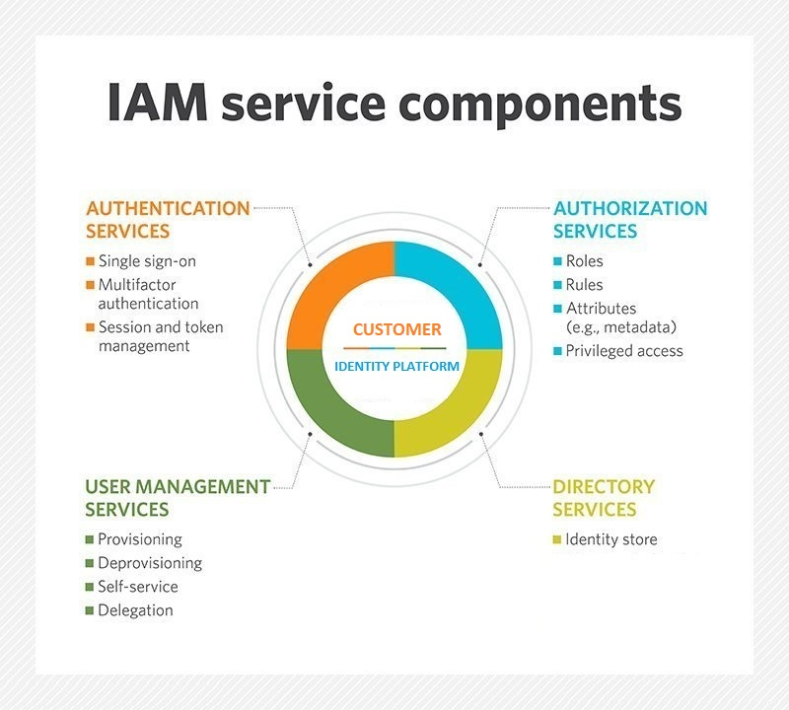
Identity Platform Overview

Slide 3
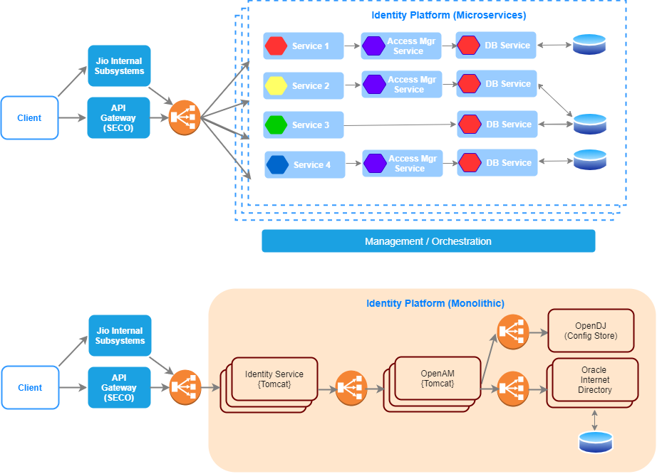
Architecture Overview

Slide 4











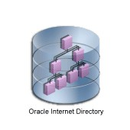








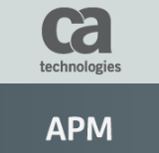






Technology Stack
05-03-2020
Reliance Jio Infocomm Ltd
4

Slide 5
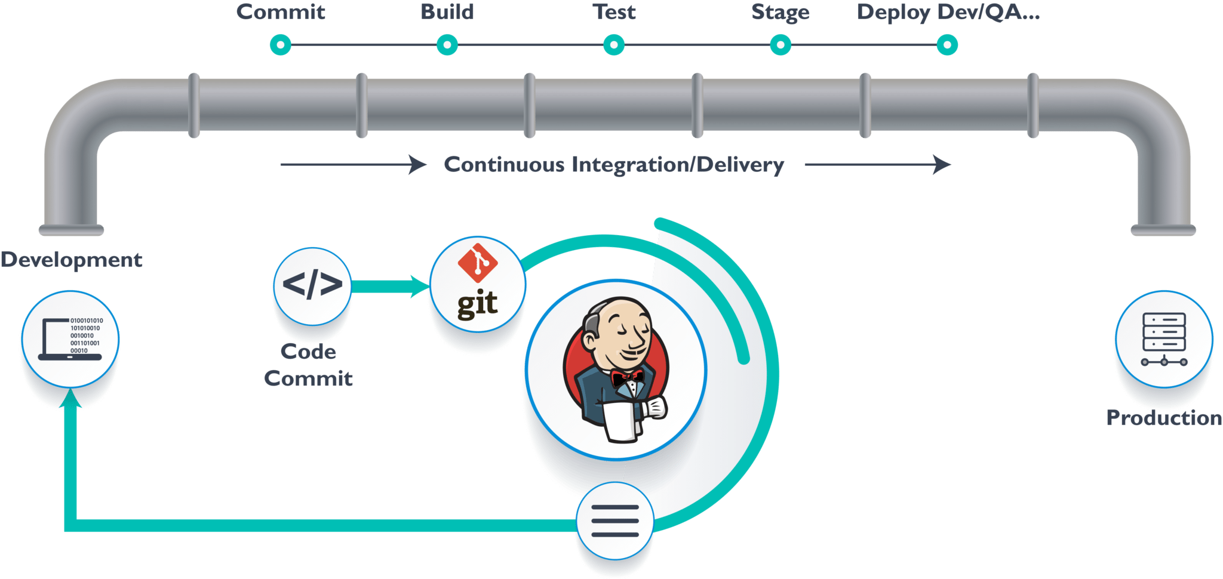
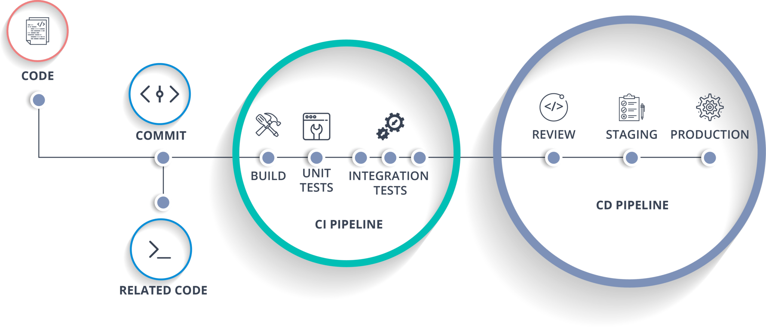
CI/CD

Slide 6
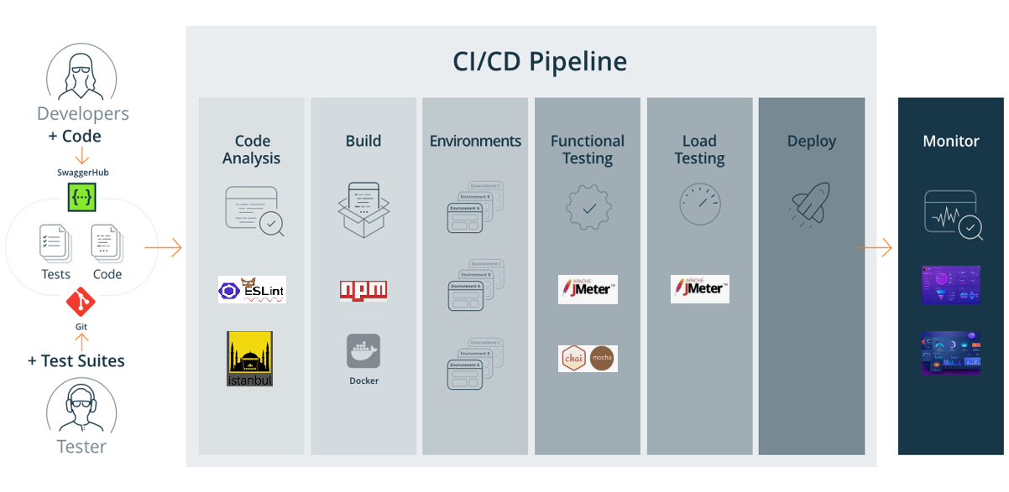

CI/CD & Automation

Slide 7
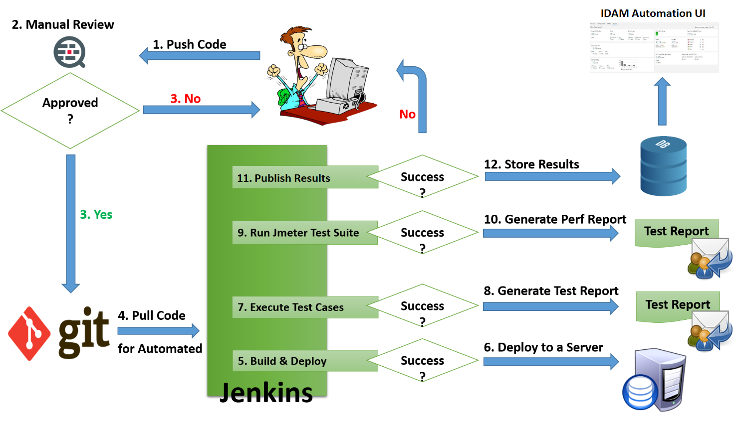
CI/CD Process

Slide 8
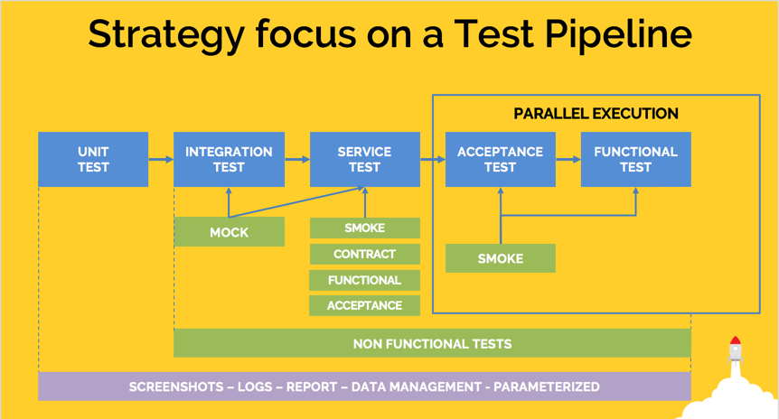
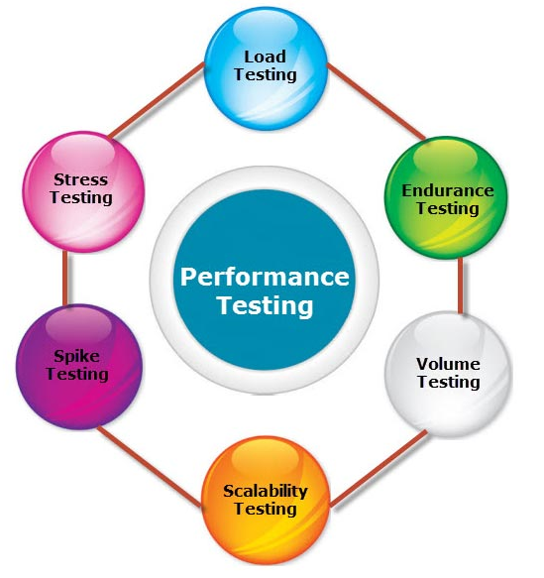
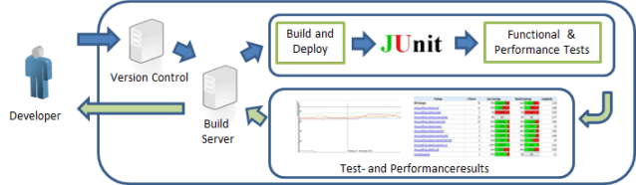
Testing Pipeline

Slide 9
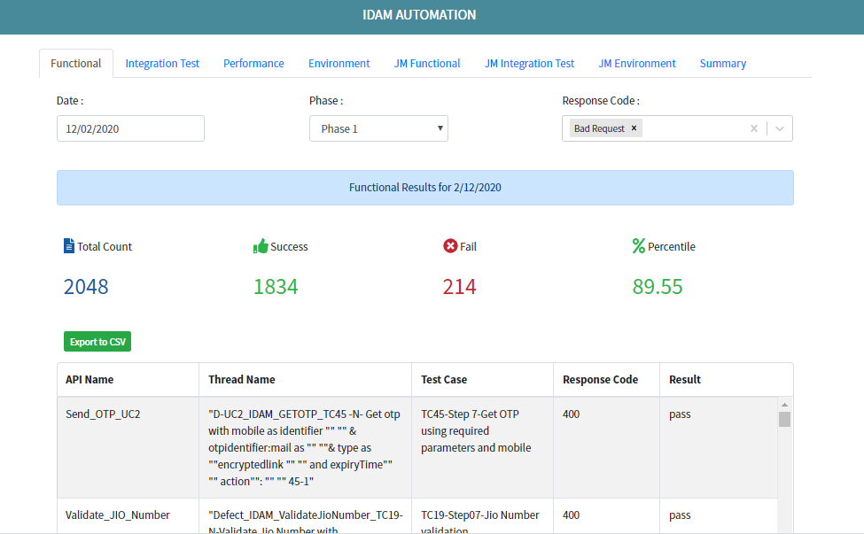
IDAM Automation UI

Slide 10
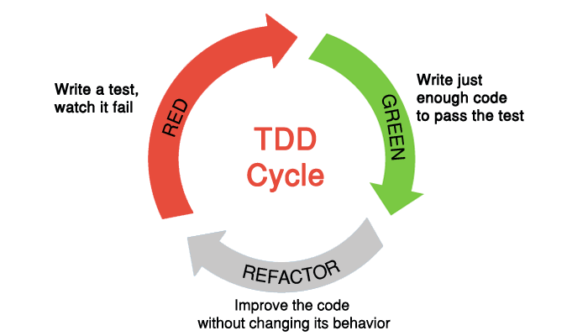
TDD – Process we follow

Slide 11
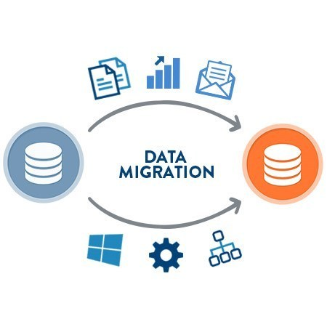

Slide 12
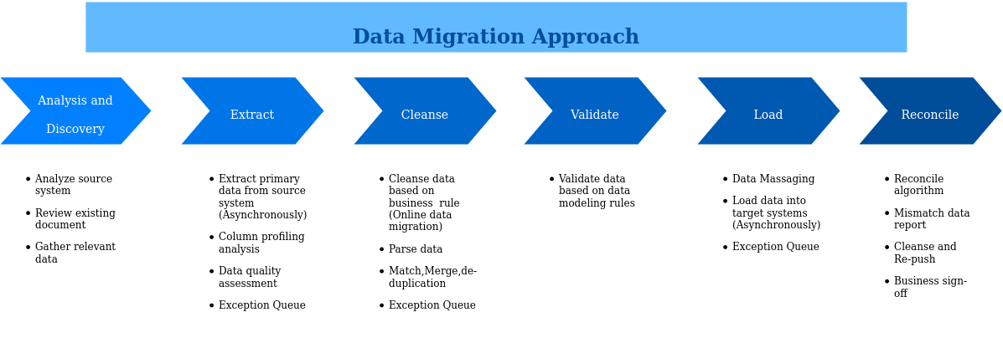
Data Migration Approach

Slide 13
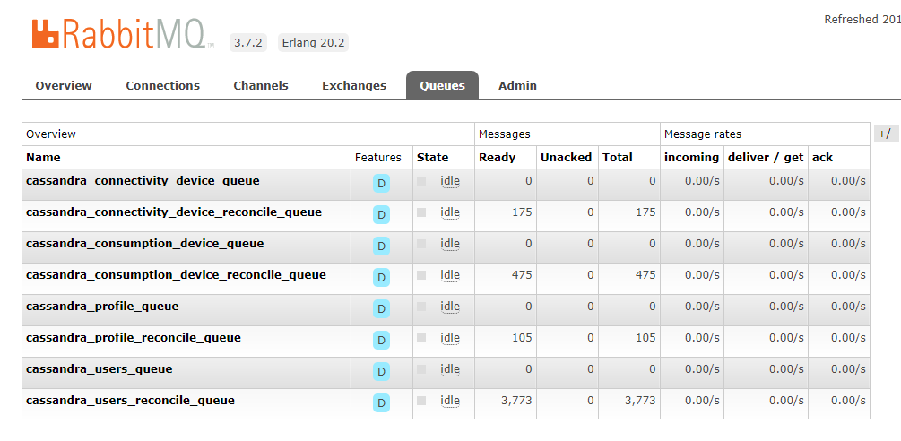
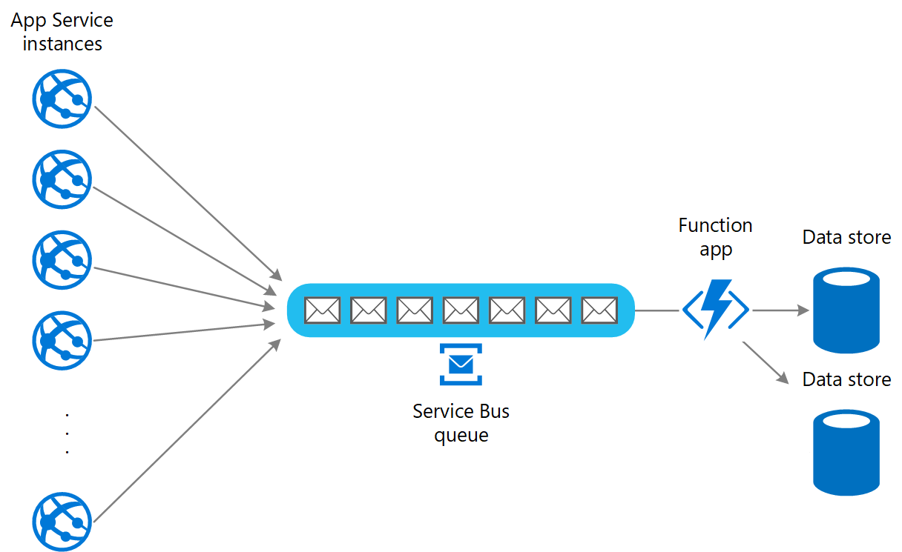
Data Migration Approach - Online

Slide 14
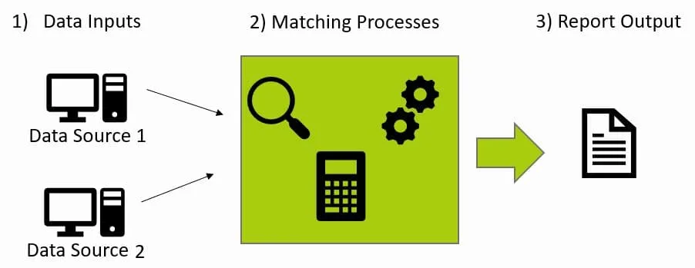
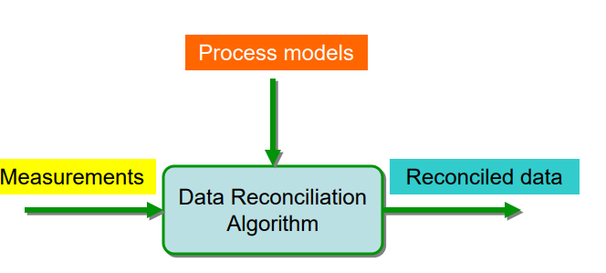
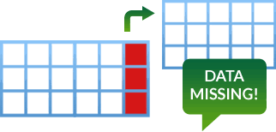
Reconciliation Tool

Slide 15


Slide 16
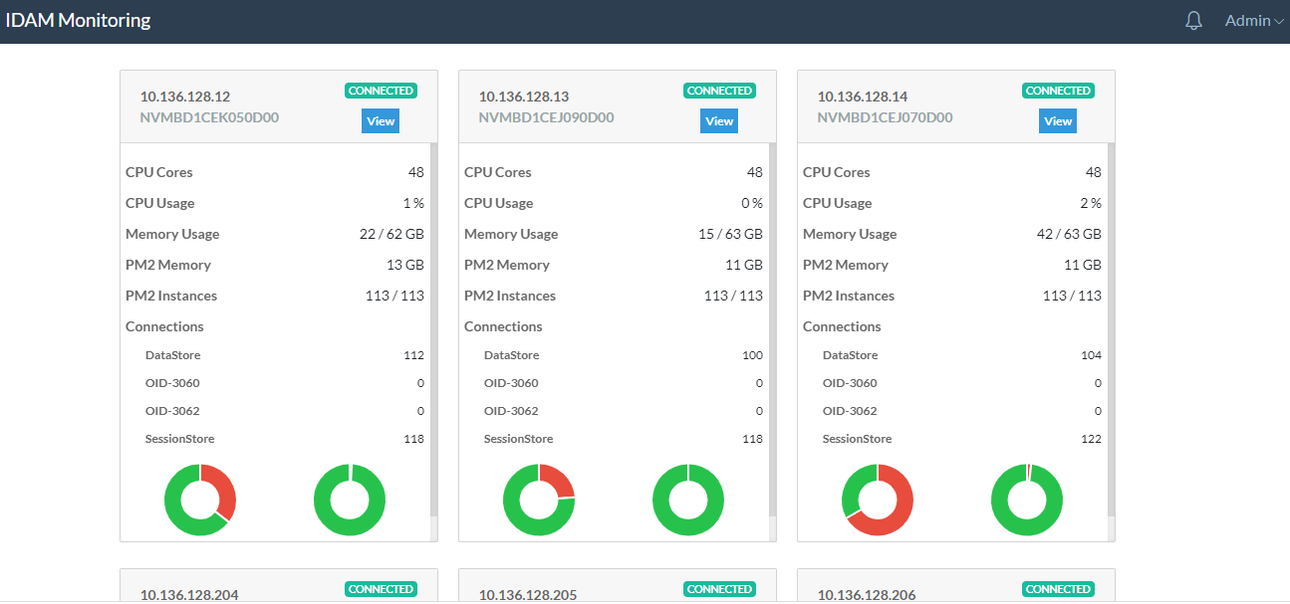
IDAM Monitoring UI

Slide 17
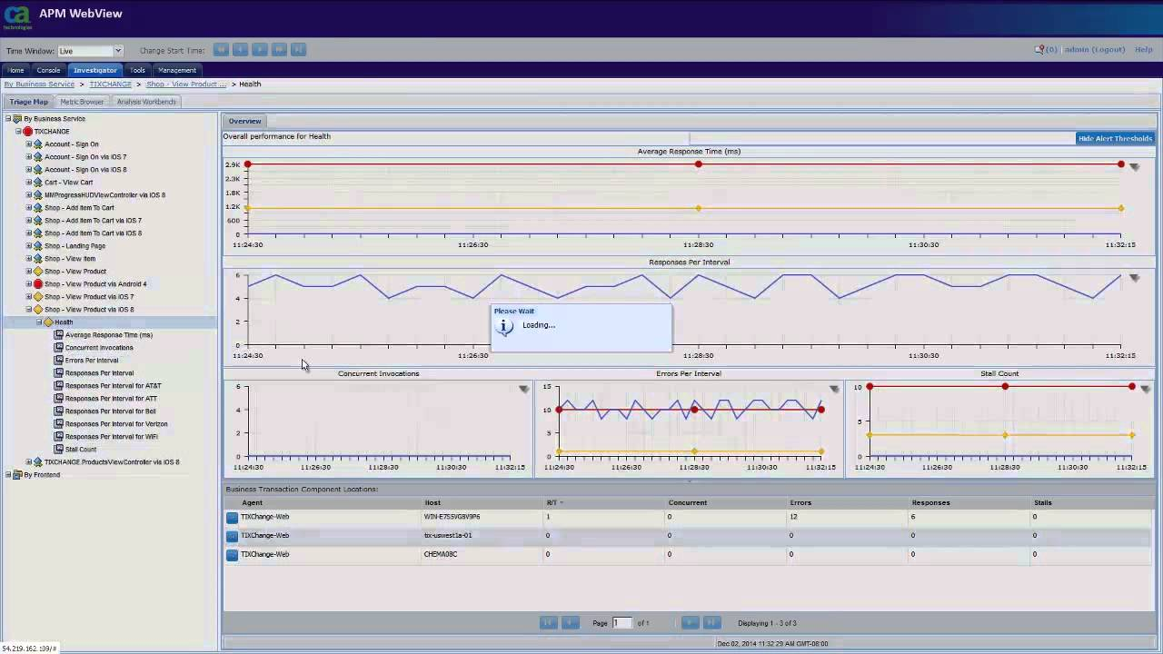

Slide 18
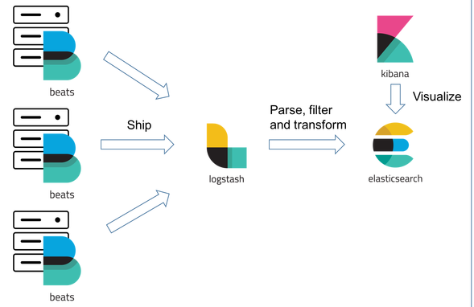
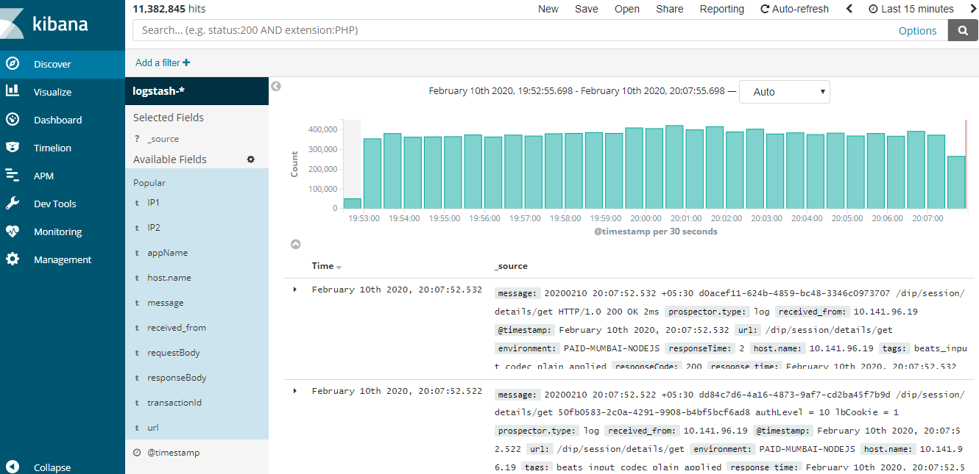
Log Aggregation & Efficient Searching

Slide 19
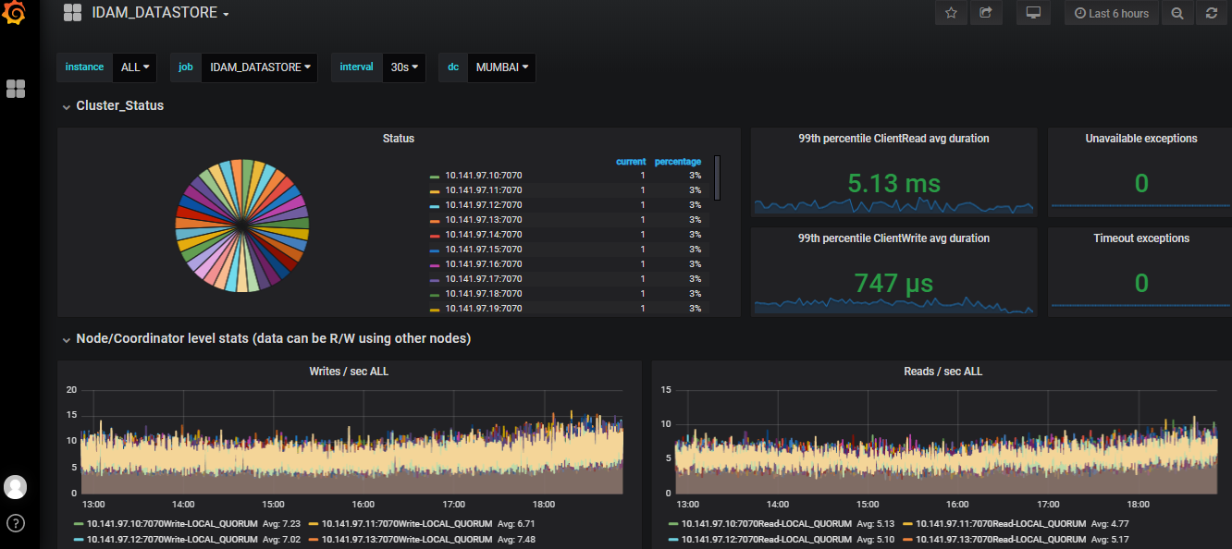
Prometheus & Grafana

Slide 20
Demo
Automation UI
Monitoring UI
ELK
Prometheus-Grafana
Online/Offline Data Migration Service Bus

